Slide 1
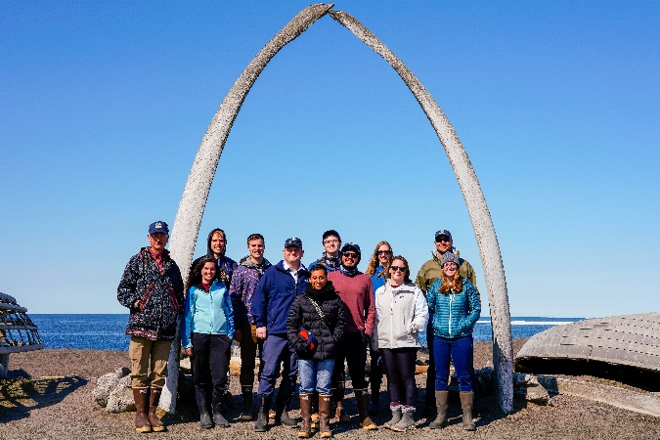
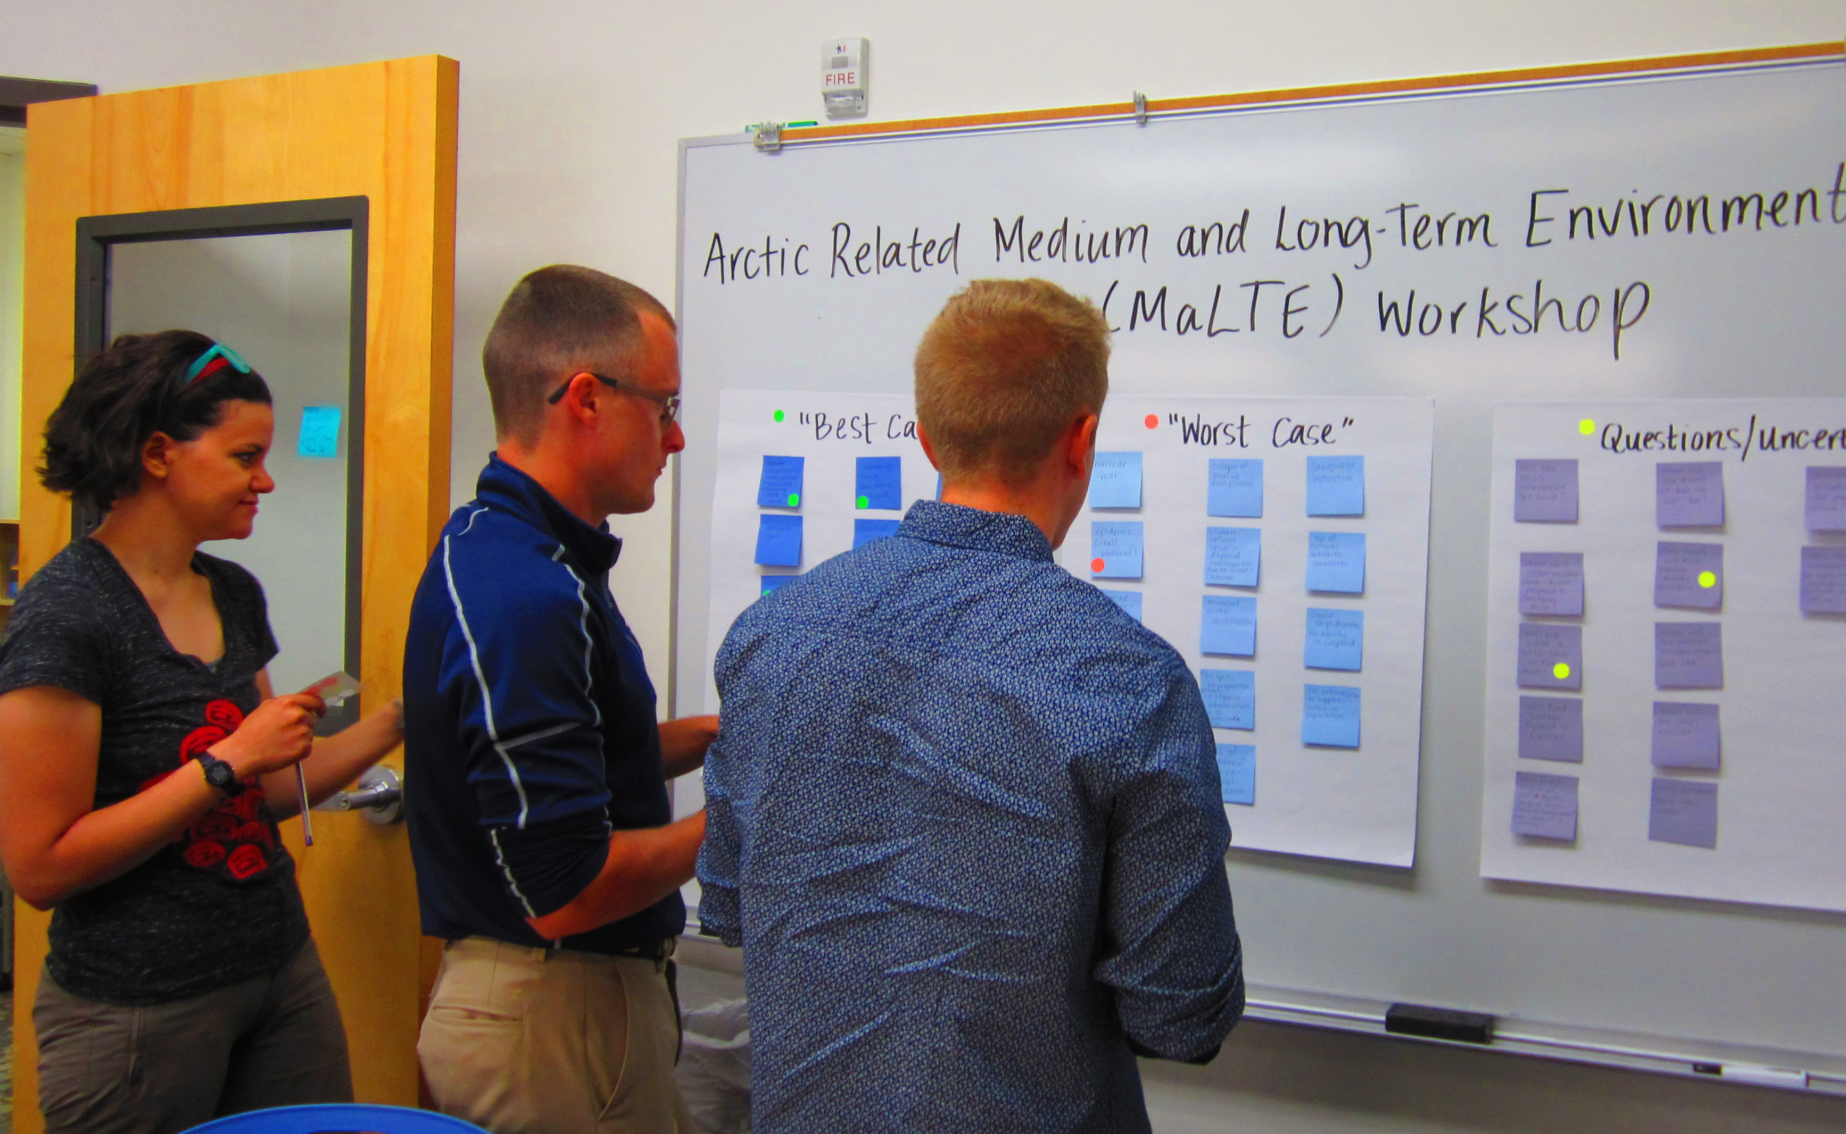
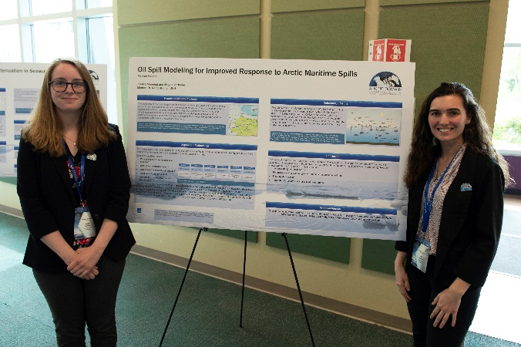
ADAC Year 7 Annual Meeting
...Via Conference Call, 2-3 June 2021
ADAC Project Briefing
ADAC’s Education Programs
Ellee Matthews, ADAC Education & Administrative Manager

Slide 2
ADAC Education Program: Structure
ADAC Program Year 7 Annual Meeting 2-3 June 2021
ADAC Fellowship Program
Workforce Development (WFD) Fellowship Program
Integrated Minority Serving Institute (MSI)/Arctic Summer Internship Program (ASIP)
The ADAC Education Program is comprised of two major components:

Slide 3
ADAC’s Workforce Development (WFD) Fellowship Program
ADAC Program Year 7 Annual Meeting 2-3 June 2021

Slide 4
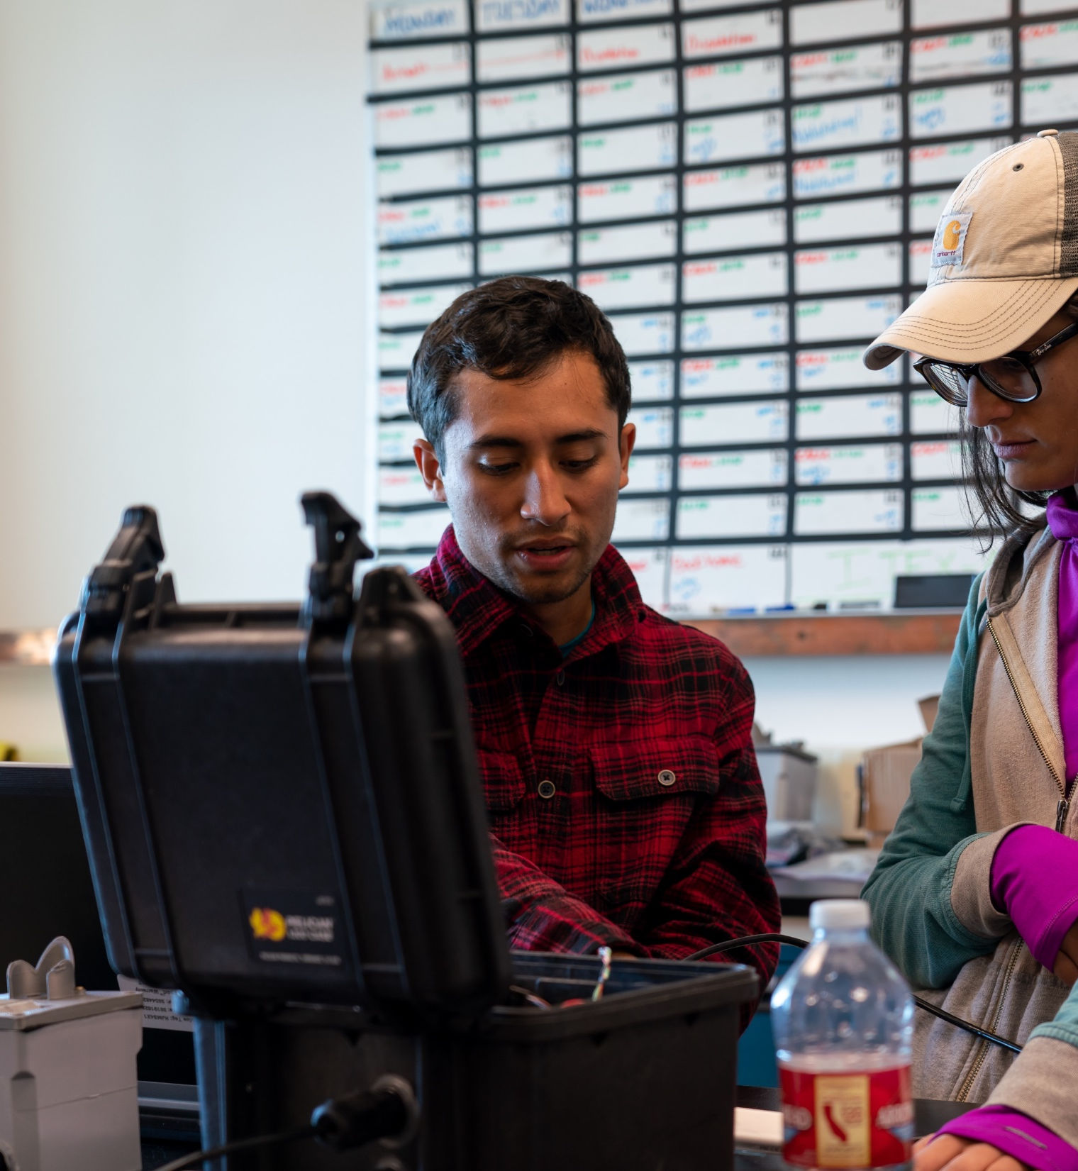
ADAC’s Workforce Development (WFD) Fellowship Program
ADAC Program Year 7 Annual Meeting 2-3 June 2021
Project Principal Investigator: Ellee Matthews (UAA)
Lead Institution: University of Alaska Anchorage (UAA)(SME)
Supporting Institutions:
  The University of Texas El Paso (MSI)
  The University of Alaska Fairbanks (SME)
  The University of New Hampshire
  The University of New Orleans
Supporting Team: Randy “Church” Kee, Dr. Douglas Causey, and Jason “Olaf” Roe

Slide 5
Workforce Development (WFD) Fellowship Program
ADAC Program Year 7 Annual Meeting 2-3 June 2021
ADAC’s WFD Fellows are funded via a DHS S&T OUP Cooperative Grant
Project Objectives:
Attract the highest caliber undergraduate and graduate students to our education programs.
Nurture and train these students for careers in DHS — related applied fields of science and technology.
Provide students opportunities for direct involvement in DHS operations and embedded research among our DHS collaborators and stakeholders.
Provide education and mentorship to students that leads to timely completion of degrees and fulfilling careers in DHS Enterprise or related fields.
Potential Impact:
Contribute to the growth of highly skilled workforce for Homeland Security agencies.
Contribute to the capability of US Coast Guard operator and in support of USCG missions in the Arctic.
MSI/ASIP Program
Workforce Development(WFD)
Fellowship Program
ADAC Education Program

Slide 6
ADAC Education Program: Eligibility, Commitment, & Support
ADAC Program Year 7 Annual Meeting 2-3 June 2021
ADAC Education Program is open to undergraduate, graduate and advanced graduate students. The following apply to all fellows and interns:
Eligibility requirements:
◦ U.S. citizenship
◦ STEM major
◦ Clear background check
◦ Achieve & maintain a cumulative GPA of 3.30
Commitment:
◦ Complete two 10-week summer internships while in the program.
◦ Actively seek and obtain employment in the Homeland Security Enterprise or a related field for at least one year after graduation.
Note: Employment can be at the state, federal or local level. Undergraduate Fellows can also defer employment to attend graduate school.
Support:
◦ Monthly stipend and tuition support (fall & spring semesters only) at defined levels for undergraduate & graduate students.
◦ Assistance in securing a 10-week internship for two summers.
◦ Mentoring and professional development through ADAC network.

Slide 7
Program Year 7 WFD Fellowship Milestones & Metrics
ADAC Program Year 7 Annual Meeting 2-3 June 2021
Milestones
Performance Metrics
Outreach & Exchange
  Participate in professional exchanges and outreach activities, this includes workshops (Arctic IoNS, MaLTE, local or national research symposiums), and Center meetings with DHS constituents.
Center Activities
  Attend monthly meetings with Center Leadership.
  In collaboration with Project PI’s and ADAC Education & Administrative Manager, develop individual student work plans for their corresponding projects.
Summer Internships
  Participate in one 10-week summer internship (two/summer during Fellowship).
GPA meets DHS requirements (3.30 on 4.0 scale).
Track progress of graduated ADAC Fellows who successfully enter the DHS Enterprise workforce, or related disciplines
Completion two 10-week summer internships for all ADAC fellows who participate in the full duration of the fellowship program.
Graduated Fellows have one year to secure employment in the Homeland Security Enterprise or related disciplines (federal/state/local gov. etc.).

Slide 8
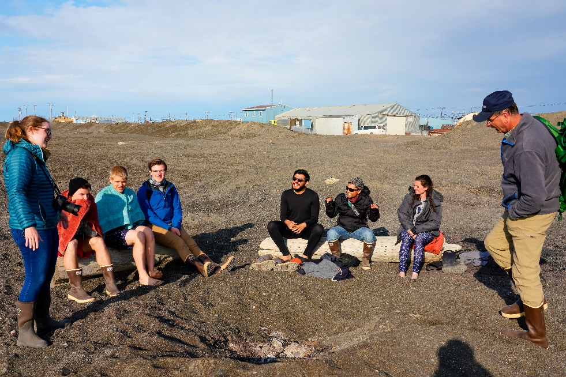
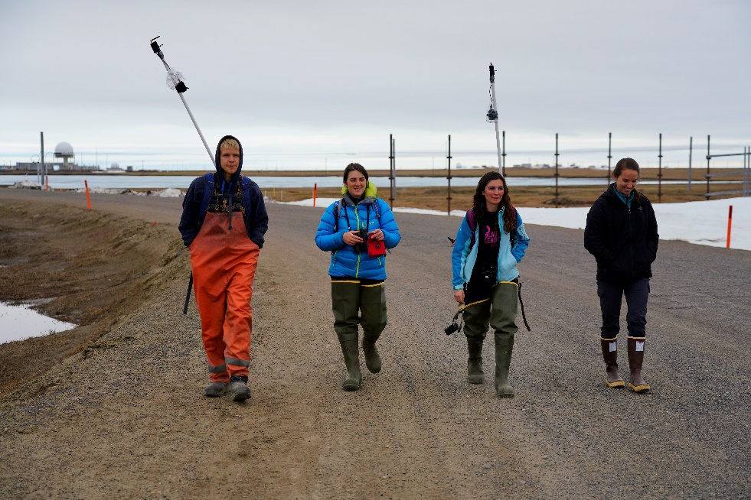
Overall ADAC Fellows in Program Year 7
ADAC Program Year 7 Annual Meeting 2-3 June 2021
Arctic Domain Awareness Center - Program Year 7 Overview of all Supported Fellows
 | Univ. of Alaska Anchorage, AK (UAA) | Univ. of Texas at El Paso, TX (UTEP)* | Univ. of New Hampshire, NH (UNH) | Univ. of New Orleans, LA (UNO)
Undergraduate | 3 | 2 | 1 | 0
Graduate | 3 | 0 | 1 | 1
Total | 6 | 2 | 2 | 1
Total Overall Active Fellows: | 11
* An accredited MSI institution

Slide 9
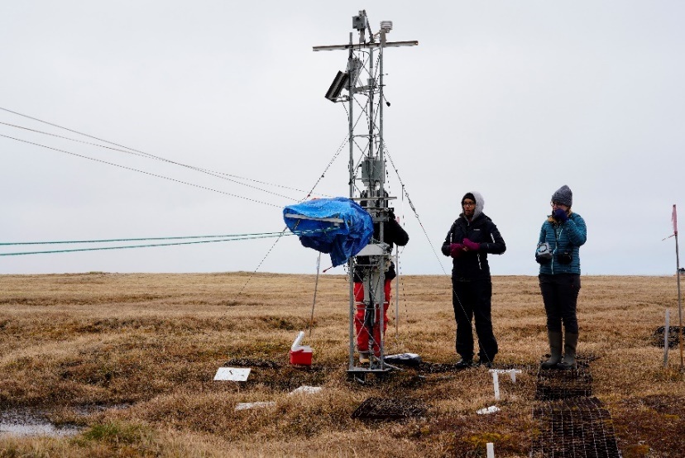
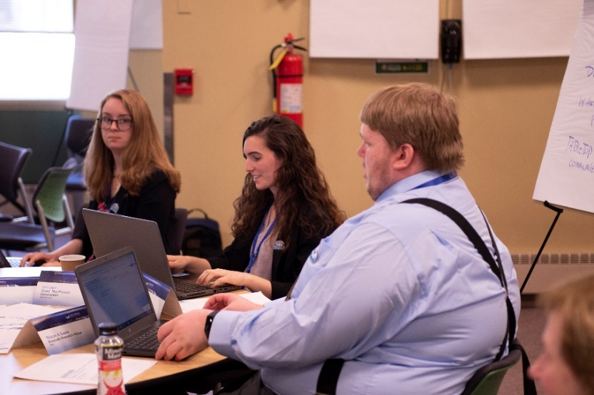
Progress: Outreach, Exchange, & Activities
ADAC Program Year 7 Annual Meeting 2-3 June 2021
Student Exchange Activities:
    October 2020: Maritime Risk Symposium
    January 2021: Alaska Marine Science Symposium
    May 2021: COE Summit
Center-Specific Projects & Activities:
    Summer 2020: ADAC’s Virtual Arctic Summer Internship Program
    September 2020: ADAC/NAADSN ACCUSARS I Workshop
    March 2021: Arctic C-ICE Conference
    March 2021: ACCUSARS II Workshop
    USCG Sector Anchorage Western & Alaska Area Committee
    Arctic and Alaska Maritime Communications & Connectivity Assessment Literature Review
    Attendance at monthly mentoring meetings with ADAC Leadership Team

Slide 10
Student Research Engagement in ADAC Projects
ADAC Program Year 7 Annual Meeting 2-3 June 2021
Project Name | Fellow(s) on Project | University
Arctic Vessel Monitoring/Geofencing: | Undergraduate Fellow/Research Associate Rachel Lewis, and Undergraduate Fellows, Raul Reutov and Jack McCaslin | UAA
Arctic Oil Spill Modeling Strategies | Graduate Fellow, Megan Verfaillie, and Undergraduate Fellow, Jessica Manning | UNH
Arctic Mussels | Graduate Fellows, Stacey Hanson, Kevin Fitzpatrick and Katherine Humpal, and Undergraduate Fellow, Cameron Carlson | UAA, UNO
Bioindicator of Oil Spills Project | Undergraduate Fellow Brenda Almanza | UTEP
Assisting USCG Sector Anchorage with the Arctic and Western Alaska Area Committee | Graduate Student/Research Associate Tristan Goers | UAA

Slide 11
Summer 2020 Ten-Week Summer Internships
ADAC Program Year 7 Annual Meeting 2-3 June 2021
Each of ADAC’s Fellows completed 10-week summer internships in 2020 (all 2020 summer internships were executed using distance technology):
  11 ADAC Fellows – Virtual Integrated MSI/ASIP Internship
  2 ADAC Fellows – Virtual Internship with Bigelow Laboratories for Ocean Sciences
  1 ADAC Fellow – Virtual Woods Hole Partnership Educational Program
  1 ADAC Fellow – Virtual Internship at UAA on Dr. Caixia Wang’s Machine Learning Project
  1 ADAC Fellow – Virtual Internship at UAA on Dr. Kathryn Milligan-Myhre Crude Oil Bioremediation Project

Slide 12
Graduated ADAC Fellows in Program Year 7
ADAC Program Year 7 Annual Meeting 2-3 June 2021
Student | University | Degree | Where are they now?
Summer 2020
Cameron Carlson | UAA | B.S. Biology and Chemistry | Completed B.S., currently serving as a chemistry and microbial analyst as he explores graduate prospects.
Fall 2020
Jessica Manning | UNH | B.S. Environmental Engineering | Completed her B.S., and currently working on an M.S. in Environmental and Civil Engineering
Raul Reutov | UAA | B.S. Computer Science | Software Engineer for NASA’s All Points
Jack McCaslin | UAA | B.S. Mechanical Engineering | Completing his B.S., and currently an intern at the Alaska Center for Energy and Power Utility
Spring 2021
Rachel Lewis | UAA | B.S. Computer Science | Pursuing employment in the field of computer sciences, as well as the potential for graduate school.
Stacey Hanson | UAA | M.S. Biology | Completing her degree at UAA, and pursuing positions in the biological sciences, with a particular focus on marine sciences.
Kevin Fitzpatrick | UAA | M.S. Biochemistry | Completing degree at UAA, just accepted a position as a Research and Field Technician with the Applied Environmental Research Center where he is working on contracts with the U.S. Army Corps. of Engineers.
Tristan Goers | UAA | M.S. Data Science | Pursuing positions in the field of GIS.
Megan Verfaillie | UNH | M.S. Environmental Engineering | To begin a PhD at UNH in remote sensing and environmental engineering during the summer of 2021.

Slide 13
Integrated Minority Serving Institute (MSI)/Arctic Summer Internship Program (ASIP)
ADAC Program Year 7 Annual Meeting 2-3 June 2021

Slide 14
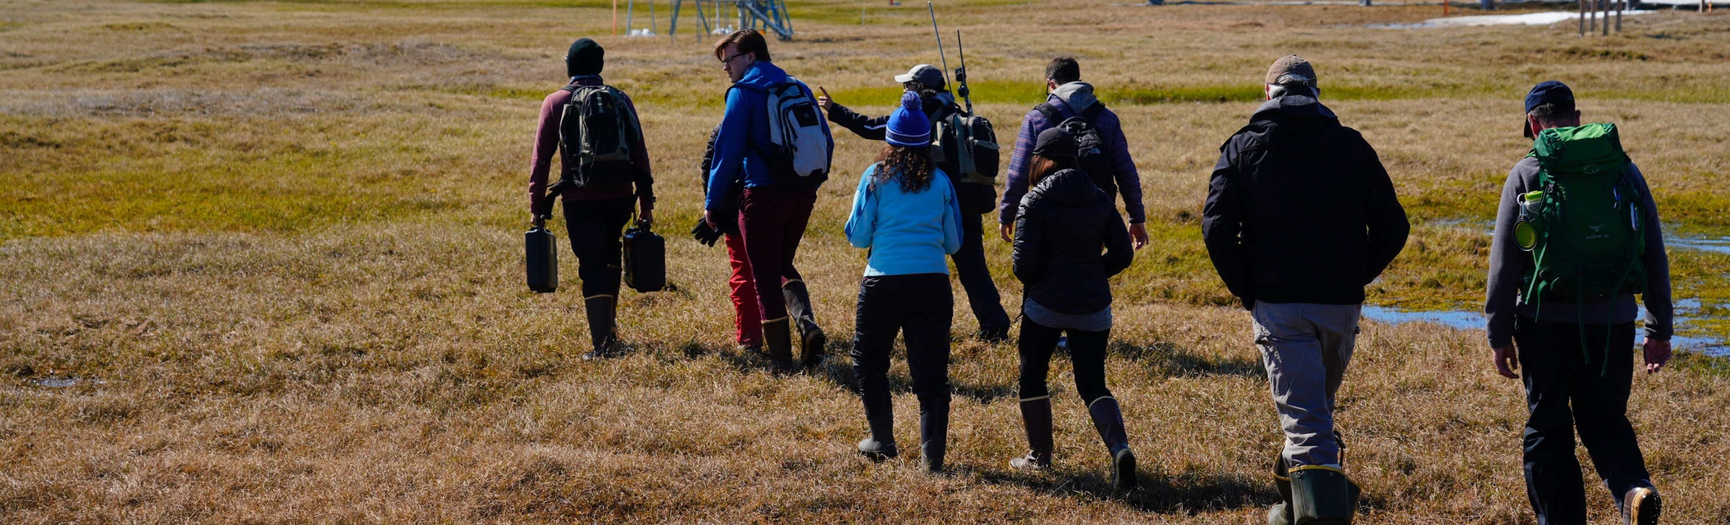
ADAC’s Integrated Minority Serving Institute (MSI)/Arctic Summer Internship Program (ASIP)
ADAC Program Year 7 Annual Meeting 2-3 June 2021
Project Principal Investigators: Craig Tweedie (UTEP) and Ellee Matthews (UAA)
Lead Institution: University of Alaska Anchorage (UAA)(SME)
Supporting Institution: University of Texas El Paso (UTEP)(MSI)
Supporting Team: Randy “Church” Kee and Jason “Olaf” Roe

Slide 15
Integrated Minority Summer Internship (MSI)/Arctic Summer Internship Project (ASIP)
ADAC Program Year 7 Annual Meeting 2-3 June 2021
Project Description:
The Arctic Summer Internship/Minority Summer Internship integrates students from under-represented classifications with designated Minority Serving Institutions (MSI) and Significant Minority Enrollment (SME) institutions. These interns join additional participating ADAC Fellows for a comprehensive summer internship program centered on Arctic field research.
ASIP is a comprehensive 10-week internship conducted by the ADAC team that provides students with the opportunity to network with multiple U.S. Federal Agencies, industry professionals, academics, Arctic operators, and Arctic community members. The internship also offers the opportunity to participate in ADAC research, independent research, and field research (COVID permitting) conducted in the U.S. Arctic.
Objective/Purpose:
To provide an Arctic focused summer internship program oriented for MSI’s, under-represented classifications, and other ADAC Fellows as a means of student workforce development and preparation for entry into the Homeland Security Enterprise or related field.
MSI/ASIP Program
Workforce Development (WFD)
ADAC Education Program

Slide 16
Program Year 7 ASIP Milestones & Metrics
ADAC Program Year 7 Annual Meeting 2-3 June 2021
Milestones
Performance Metrics
Recruit five students from under-represented minorities to participate in ADAC’s Arctic Summer Internship Program (ASIP) and integrate the MSI students with participating ADAC fellows.
Outline expectations and opportunities for recruited students by providing advance preparation information and associated materials.
Recruited students will travel to Anchorage, AK to participate in ADAC’s ASIP.
Recruiting five students from under-represented minorities: Program is considered “Success” when full recruitment goal is achieved.
Visiting minority students who then decide to compete for a DHS COE student fellowship program, because of participating in the ADAC MSI. Program is considered “Success” when one student considers pursuing a follow-on intern with either ADAC or another DHS COE.
Visiting minority students who follow-on through a student relationship to a DHS COE who then successfully graduate and enters into employment with the HSE or related field. Program is considered “Success” when one student takes this path over the duration of the ADAC MSI program.

Slide 17
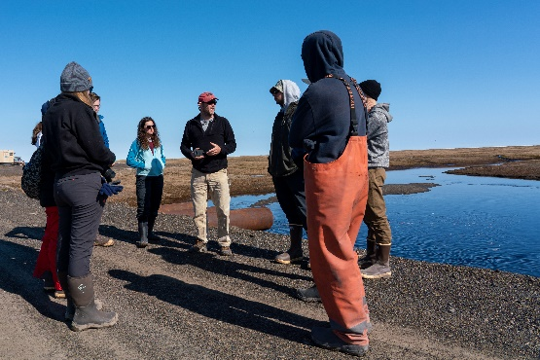
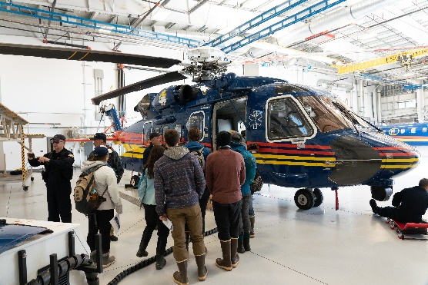
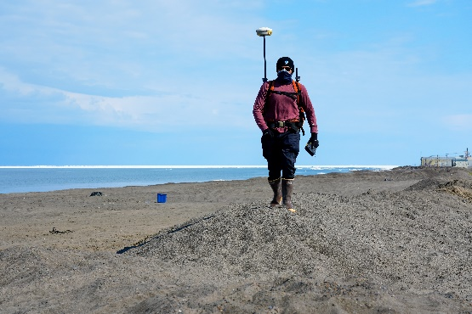
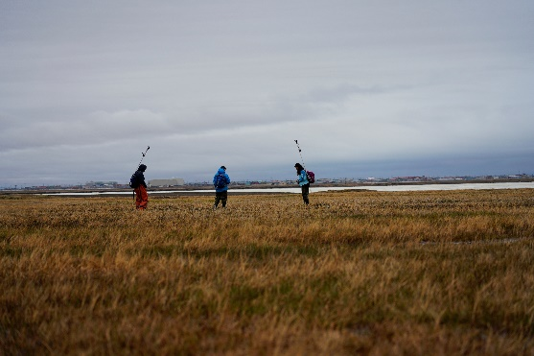
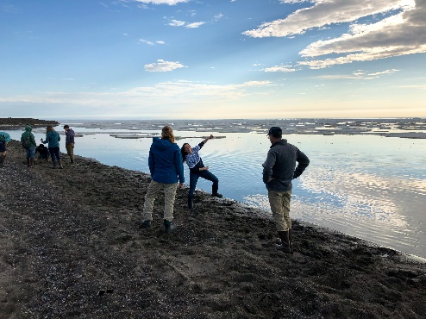
MSI/ASIP Virtual Program 2020: Overview
ADAC Program Year 7 Annual Meeting 2-3 June 2021
Program Leadership: PI – Dr. Craig Tweedie (UTEP); Co-PI – Ellee Matthews
Dates: June 1 – August 7
Delivery: Microsoft Teams, Zoom, and Google Calendar
Students:
  11 Total Students:
    6 University of Alaska Anchorage Students
    1 U.S. Naval Academy Midshipman
    1 University of Texas El Paso Student
    1 University of New Orleans Student
    1 University of North Carolina Wilmington Student
    1 University of New Hampshire Student

Slide 18
MSI/ASIP Virtual Program 2020: Components & Structure
ADAC Program Year 7 Annual Meeting 2-3 June 2021
Program Components
Program Structure
Professional Development
Group Project
Week 1
Orientation
Weeks 2-3
Arctic Alaska
Weeks 4-5
U.S. Arctic Focus
Week 6
International Arctic Focus
Week 7
Arctic Disasters and Response
Week 8
Arctic Innovations and Technology
Week 9
Student Presentations Week
Week 10
Program Wrap-Up and Professional Development Focus
Student Presentations
Weekly Guest Presentations
Independent Research Project
Virtual ASIP Program
Weekly Lectures

Slide 19
Virtual ASIP 2020 – Guest Presenters
ADAC Program Year 7 Annual Meeting 2-3 June 2021
Randy “Church” Kee – Executive Director of the Arctic Domain Awareness Center
Dr. Douglas Causey – Principle Investigator of the Arctic Domain Awareness Center
Jason “Olaf” Roe – Associate Director & Senior Research Professional of the Arctic Domain Awareness Center
Kelsey “Doc Freeze” Frazier – Research Associate at the Arctic Domain Awareness Center
Capt (Ret) Buddy Custard & Dr. Shawn Butler – Principle Investigators on ADAC’s Arctic Geofencing Project
Kaare Erickson –Ukpeaġvik Iñupiat Corporation (UIC) Science
Dr. John Farrell – Executive Director of the U.S. Arctic Research Commission
Mr. Delbert Rexford - President and CEO of Ukpeaġvik Iñupiat Corporation (UIC)
Dr. Paul Berkman - Director of Science Diplomacy at the Fletcher School of Science Diplomacy and Law at Tufts University
Justin Mitchak Gatten - The North Slope Borough Risk Management Department
Dr. Robert Suydam - The National Wildlife Service in Utqiagvik, AK
Sara Thomas – The Native Movement
Gil Castellanos – U.S. Representative for the Arctic Council Conservation of Arctic Flora and Fauna Working Group

Slide 20
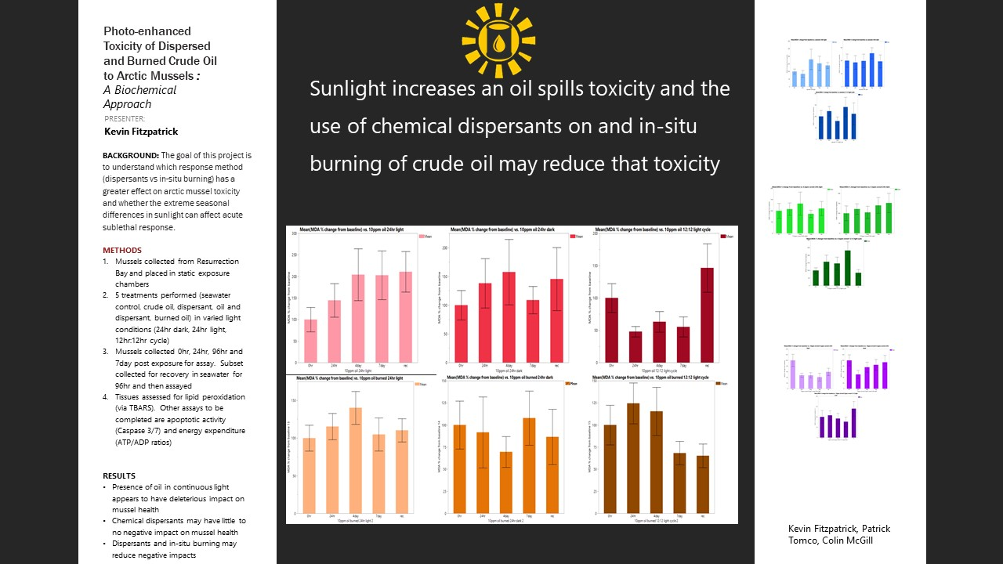
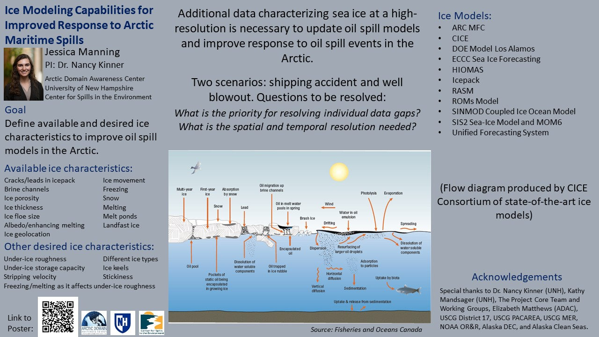
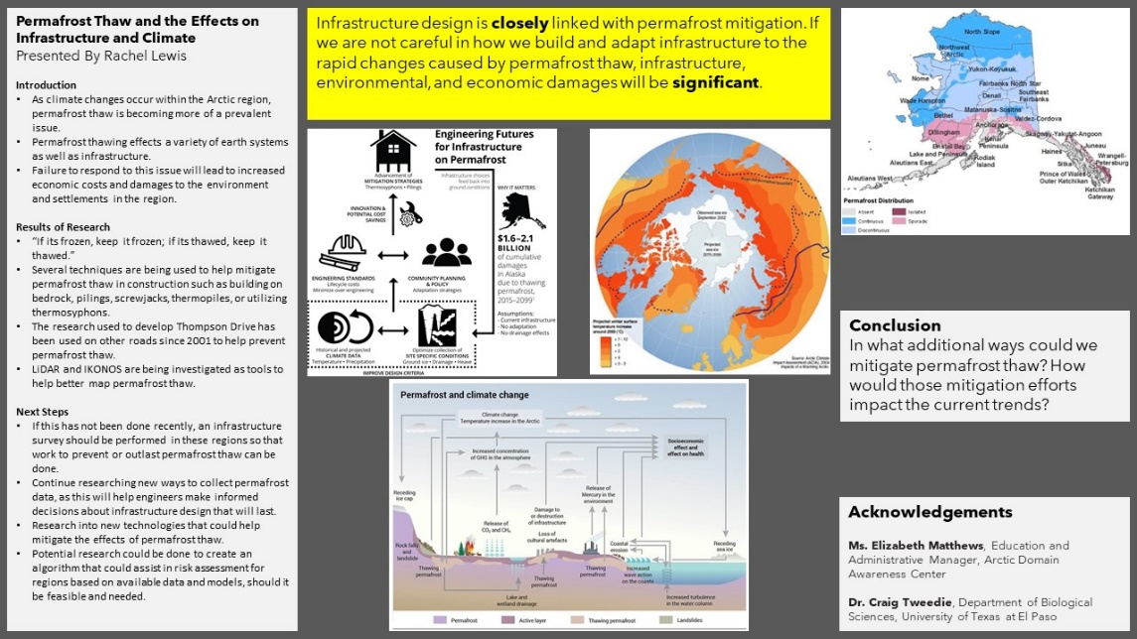
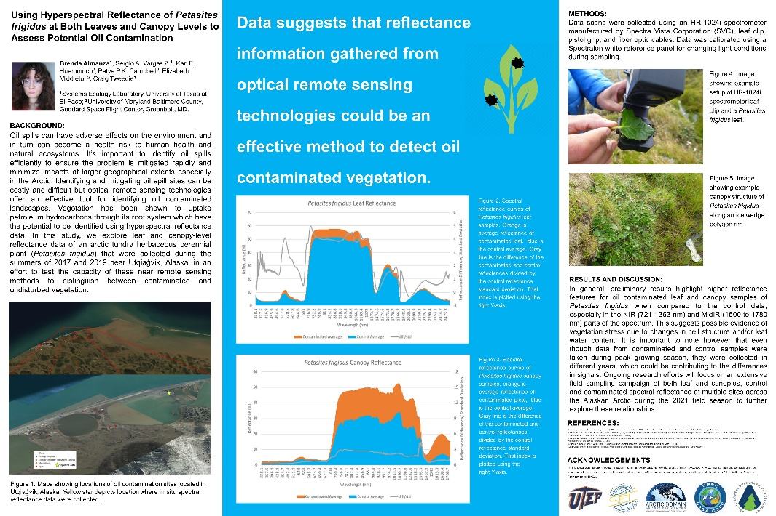
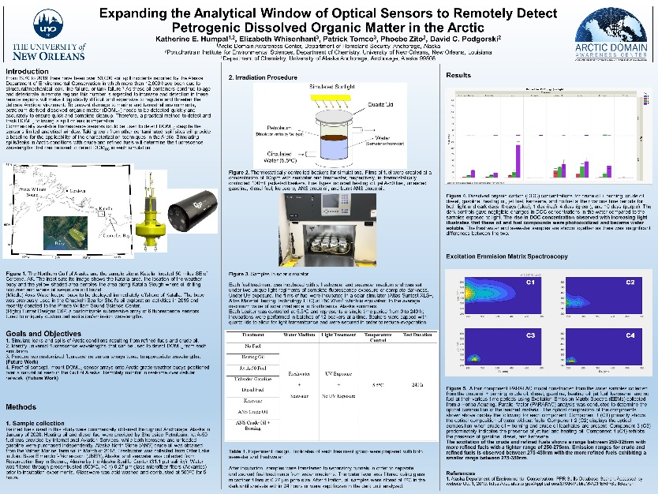
ASIP 2020: Student Independent Research Projects
ADAC Program Year 7 Annual Meeting 2-3 June 2021

Slide 21
Outcomes of the 2020 Virtual Arctic Summer Internship Program
ADAC Program Year 7 Annual Meeting 2-3 June 2021
Students submitted their independent research project posters to three separate research symposiums, including the Alaska Marine Science Symposium, the Maritime Risk Symposium, and the UTEP Undergraduate Research Symposium.
  One poster received top scores at two of these events
Two new students continued with an ADAC fellowship following the summer program: Katherine Humpal (UNO) and Brenda Almanza (UTEP)
One student was offered a follow-on internship with Bigelow Laboratory for Ocean Sciences for summer 2021
All students gained invaluable experiences with networking, developing research plans, creating research posters, presentation skills, critical thinking, and teamwork.

Slide 22
2021 Integrated Minority Serving Institute (MSI)/Arctic Summer Internship - Onboarding Program
ADAC Program Year 7 Annual Meeting 2-3 June 2021

Slide 23
Summer 2021 Integrated MSI & ASIP:
Summer Onboarding Program
ADAC Program Year 7 Annual Meeting 2-3 June 2021
Milestones
Performance Metrics
Recruit two students from under-represented minorities to participate in ADAC’s Arctic Summer Internship.
Outline expectations and opportunities for recruited students by providing advance preparation information and associated materials.
Recruited students will participate in the summer onboarding program, to begin in July 2021.
Recruited students will then progress from the summer onboarding program, into ADAC fellows during the 2021/2022 academic year.
Recruited students will travel to Alaska and participate in ADAC’s 2022 ASIP.
Recruiting two students from under-represented minorities: Program is considered “Success” when full recruitment goal is achieved.
Visiting minority students who follow-on through a student relationship to a DHS COE who then successfully graduate and enters into employment with the HSE or a related discipline. Program is considered “Success” when one student takes this path over the duration of the ADAC Education Program.

Slide 24
MSI/ASIP Onboarding Program 2021: Overview
ADAC Program Year 7 Annual Meeting 2-3 June 2021
Program Leadership: PI – Dr. Craig Tweedie (UTEP); Co-PI – Ellee Matthews
Dates: July 1 – August 20
Delivery: Hybrid (COVID permitting) – In-person and virtual (Microsoft Teams, Zoom, and Google Calendar)
Students:
  7 Total Anticipated Students:
    3-4 University of Alaska Students
    1 University of New Hampshire Student
    1 University of Texas El Paso Student
    1 University of New Orleans Student

Slide 25
MSI/ASIP Onboarding Program 2021: Components & Objectives
ADAC Program Year 7 Annual Meeting 2-3 June 2021
Program Components
Program Objectives
Guest Presentations
Independent Projects and Assignments
Summer Onboarding Program
Workforce and Professional Development Lectures
To prepare students to enter the academic research field from an ADAC fellow perspective, while providing the students with a foundational understanding of the Arctic domain.
To utilize an interdisciplinary and holistic approach to teach students of the interconnected nature of the Arctic domain.
To introduce students to the Homeland Security Enterprise, the role of the USCG in this Enterprise, as well as in the Arctic more broadly.
To prepare students for their role as academic fellows during the academic year, 2021/2022 with ADAC research teams.

Slide 26
Overview of the Total Numbers
ADAC Program Year 7 Annual Meeting 2-3 June 2021
Total number of ADAC fellows and interns: 41
Total number of students from under-represented classifications in STEM: 16
Post Graduation Pathways:
  Number of students who pursued higher education: 13
  Number of students who pursued work with the Federal Government: 12
    Federal Agencies Include: TSA, the U.S. Army Corp of Engineers, NASA, U.S. National Laboratories, U.S. Navy, and the U.S. Coast Guard
  Number of students who have gone to teach STEM education: 2
  Number of students working towards completing their degree: 14

Slide 27

In Summary…
ADAC Program Year 7 Annual Meeting 2-3 June 2021
In ADAC’s Program Year 7, 9 students have graduated from the Fellowship program, 2 students transitioned from the 2020 summer internship program to the fellowship program, and 7 students are anticipated to participate in ADAC’s 2021 Summer Onboarding Program to pursue an ADAC Fellowship for the 2021/2022 academic year. .
Career options and interest have been looked at on individual basis, and mentoring by ADAC staff has been tailored to assist graduates to transition to Homeland Security Enterprise and/or related employment.

Slide 28
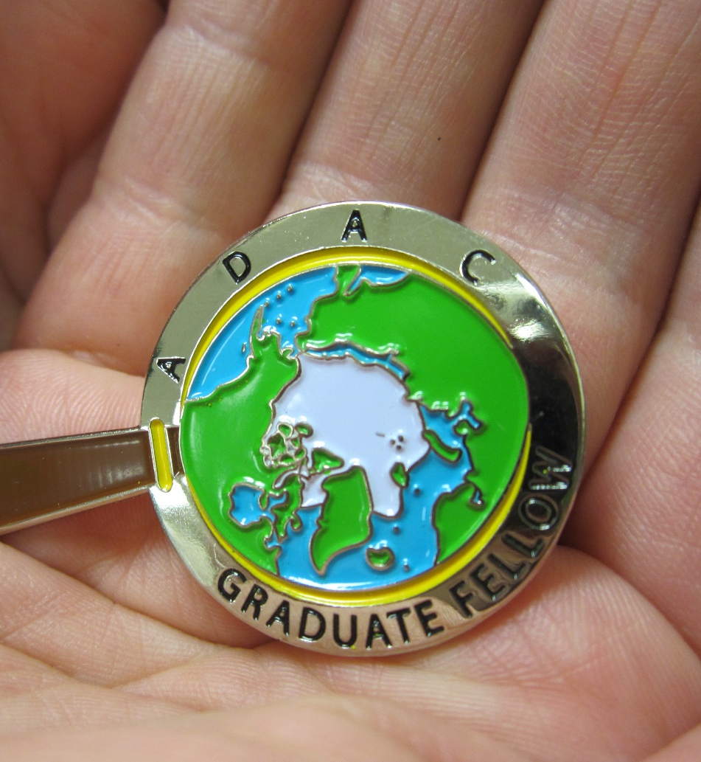
Thank you.
Ready for questions…
ADAC Program Year 7 Annual Meeting 2-3 June 2021
Feedback?
What are we missing?
What can we improve?
Who should we connect with to improve our success?
Notes:
Thank you for the gift of your time and attention.

